Slide 1
Advanced Certification Program in Software Testing in collaboration with IBM
Name : Nivedha Ganesan . MCA.,.
Trainee Name : Vishakha Desai.

Slide 2
Advanced Certification Program in Software Testing in collaboration with IBM
Manual Testing
MySQL
Selenium
Maven
POSTMAN
java
Jira
Cucumber
API Testing
JMeter

Slide 3

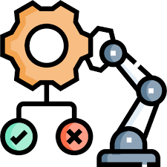
TESTINNG STRATEGIES
MANUAL PROJECT
LINK:https://github.com/NivedhaRajivGandhi/Edubridge_ManualProject
Project Name : Blood bank Today
AUTOMATIONPROJECT
LINK: https://github.com/NivedhaRajivGandhi/Edubridge_AutomationProject
PROJECT NAME : Insurance Broker System
Manual testing involves human intervention to evaluate software for defects or issues. It includes activities like test case execution, defect reporting, and regression testing to ensure software quality.
Automation testing utilizes specialized software tools to execute pre-scripted tests on a software application, comparing actual outcomes with predicted outcomes. It aims to increase efficiency, repeatability, and accuracy in the testing process, especially for repetitive tasks and regression testing.

Slide 4
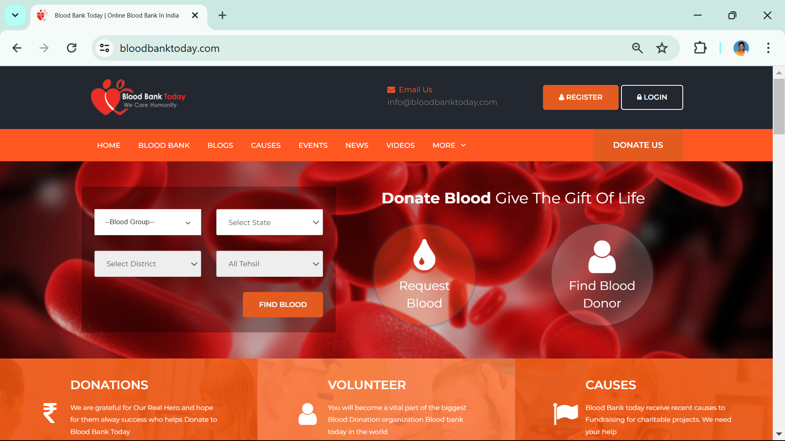
Manual project : Blood Bank Today
Scope:
The website "bloodbanktoday.com" seems to be a platform related to blood banking, presumably aimed at facilitating blood donation, managing blood bank inventories, and possibly providing information about blood-related issues.
Types of Testing Used:
Unit Testing
Integration Testing
Performance Testing
Cross Browser Testing
System Testing
Smoke Testing
UI Testing
Link :https://bloodbanktoday.com/

Slide 5
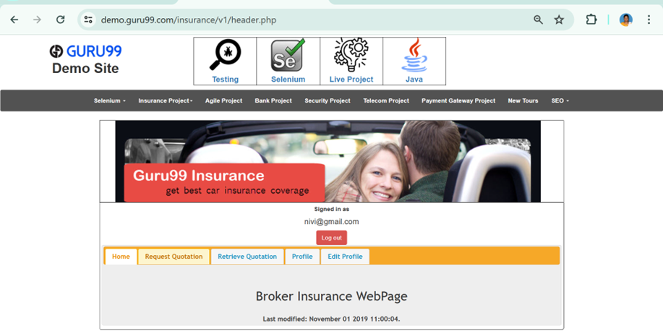
Automation Project : Insurance Broker System
Scope:
The Guru99 Insurance Project offers a comprehensive web application for learning and testing, encompassing functionalities such as user management, policy and claim management, premium calculation, and administrative functions. It serves as a versatile platform for hands-on testing experience, facilitating understanding of software testing principles and techniques.
TYPES OF TESTING USED
Cross Browser Testing
URL Verification
Page Title Verification
Smoke Testing
Parallel Testing
Multiple Testing
Main-Functionality
Frame works
DDT
KDT
BDT
HYBRID
TestNG
Link : https://demo.guru99.com/insurance/v1/index.php

Slide 6

THANK YOU Presented by: Nivedha Ganesan rajivnivedha@gmail.com

